Slide 1
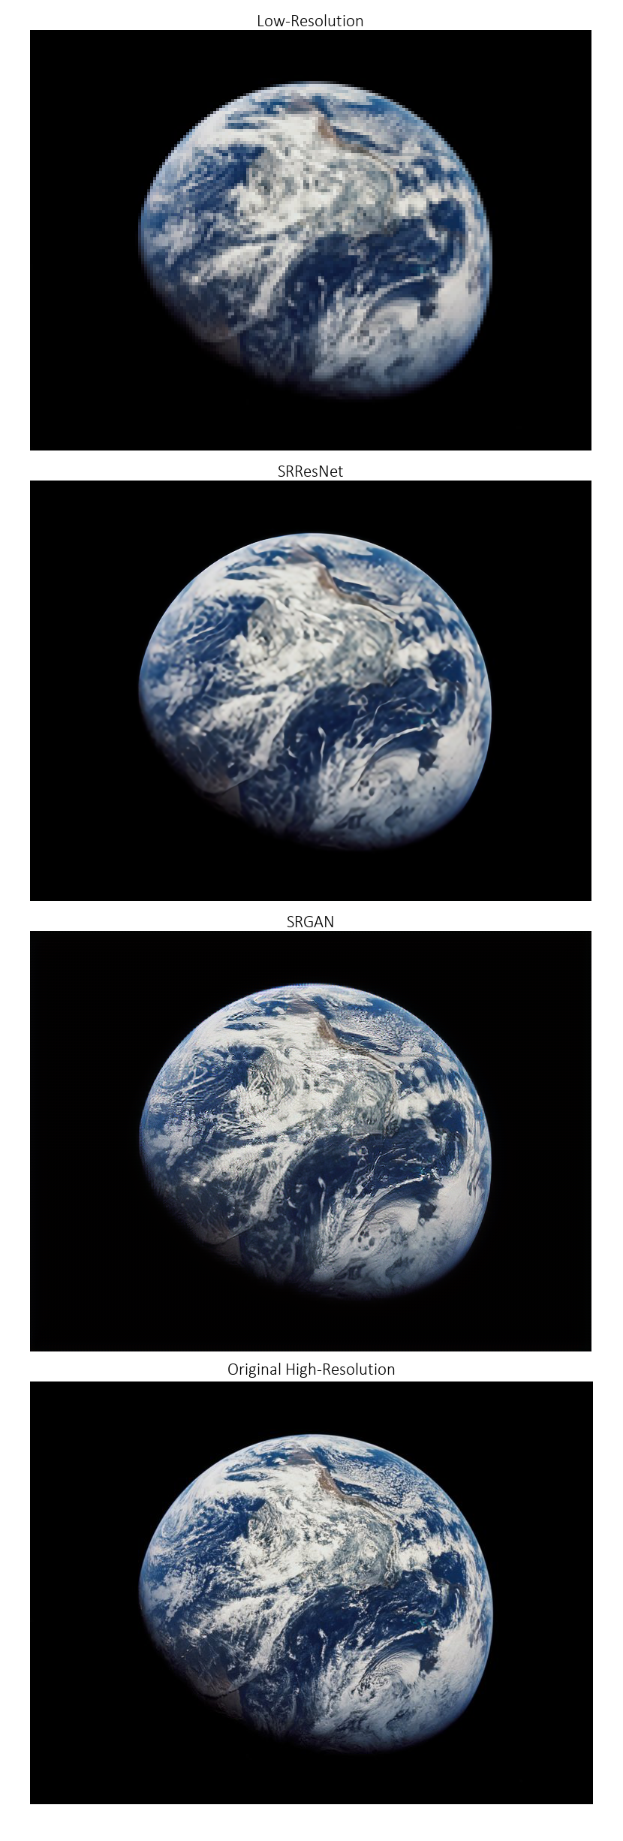
Image Super Resolution
Deep Leaning approach for
single image super resolution (SISR)

Slide 2
Introduction
Classical methods
Deep Neural networks based approach
SR-ResNet
SR-GAN
Loss Function
Results And comparison
Graph convolution
Practical problems
Solutions
SR-GCN
Results
Future improvement
References

Slide 3
Introduction
Increasing resolution of images is always demanded and there are multiple ways to do this.
One approach is to enhance hardware to capture better pictures. But this is limited due to costs and technology.
Another approach is in software domain which we use techniques for producing HR image from LR images.
In this Project we consider the second one because of its availability and efficiency. So we encounter with two approaches: 1- classical method, 2- Deep Learning based method.

Slide 4
Classical methods
At the first most methods are based on frequency methods. These methods use relation between HR image, LR images in frequency domain and have high computational efficiency but are sensitive to errors and noise [1]. So advances in spatial domain are achieved. For example :
Non uniform interpolation [2]
Iterative back projection (IBP) [3]
Projection onto convex set (POCS) [4]
Regularized methods [5]

Slide 5

The Regularized Method
In Regularized method we assume this objective model:
$${y_{k}=D}_{k}B_{k}M_{k}x+n_{k} , k∈\left\{1,2,…,K\right\}$$
where $D_{k}$ is down sampling operator, $B_{k}$ is motion blur operator and $M_{k}$ is wrapping operator. For simplicity we call $H_{k}$ the product of $D_{k}B_{k}M_{k}$.
Next we have this optimization problem :
$\text{arg}\min_{x}{\sum_{k=1}^{K}{ρ(y_{k}−H_{k}x})+λU\left(x\right)}≜\text{arg}\min_{x}{−\ln{(p\left(x | y\right)}}$
$ρ\left(y_{k}−H_{k}x\right)=ρ\left(n_{k}\right)≜−\ln{p\left(n_{k}\right|x)}$ can be square function if our noise is Gaussian or can be ABS function if our noise Laplacian.
So we can set $L_{p}$ norm for liklihood.

Slide 6
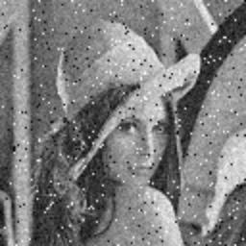



Low Resolution
PSNR = 26.026
Laplacian Map
PSNR = 28.040
Guassian Map
PSNR = 26.108
L_1.3 Map
PSNR = 28.311

Slide 7
Deep Neural networks based approach
We use three kind of network for this task :
SR-ResNet [6]
SR-GAN [7]
SR-GCN
We implement all of these networks from scratch using pytorch and DIV2K.
We should note that the first two one are not new approach and before us others implemented them, but the third approach is new and to our knowledge no one hasn’t implemented that.

Slide 8
sR-ResNet
This approach is based on ResNet architecture that published in 2015 [8].
This has 16 residual blocks which each of them consist of 2 convolution block with batch normalization and PReLU activation function.
SR-ResNet has one unit in addition to ResNet. This unit is up-sampling and it just increase the channels and the shuffle them to increase the size of picture. For example if out feature map has size (64, H, W), then we have (256, H, W) feature map, after we shuffle channels together so at the final we have feature map of size (64, 4H, 4W).
Our train dataset contain high resolution images and crossponding low resolution image that down-sampled with factor 4.
We augment our train set from 800 image to 8000 image with transforms like add gaussian noise, flip, rotation, …
All of code is available in “image_super_resolution.ipynb”.

Slide 9
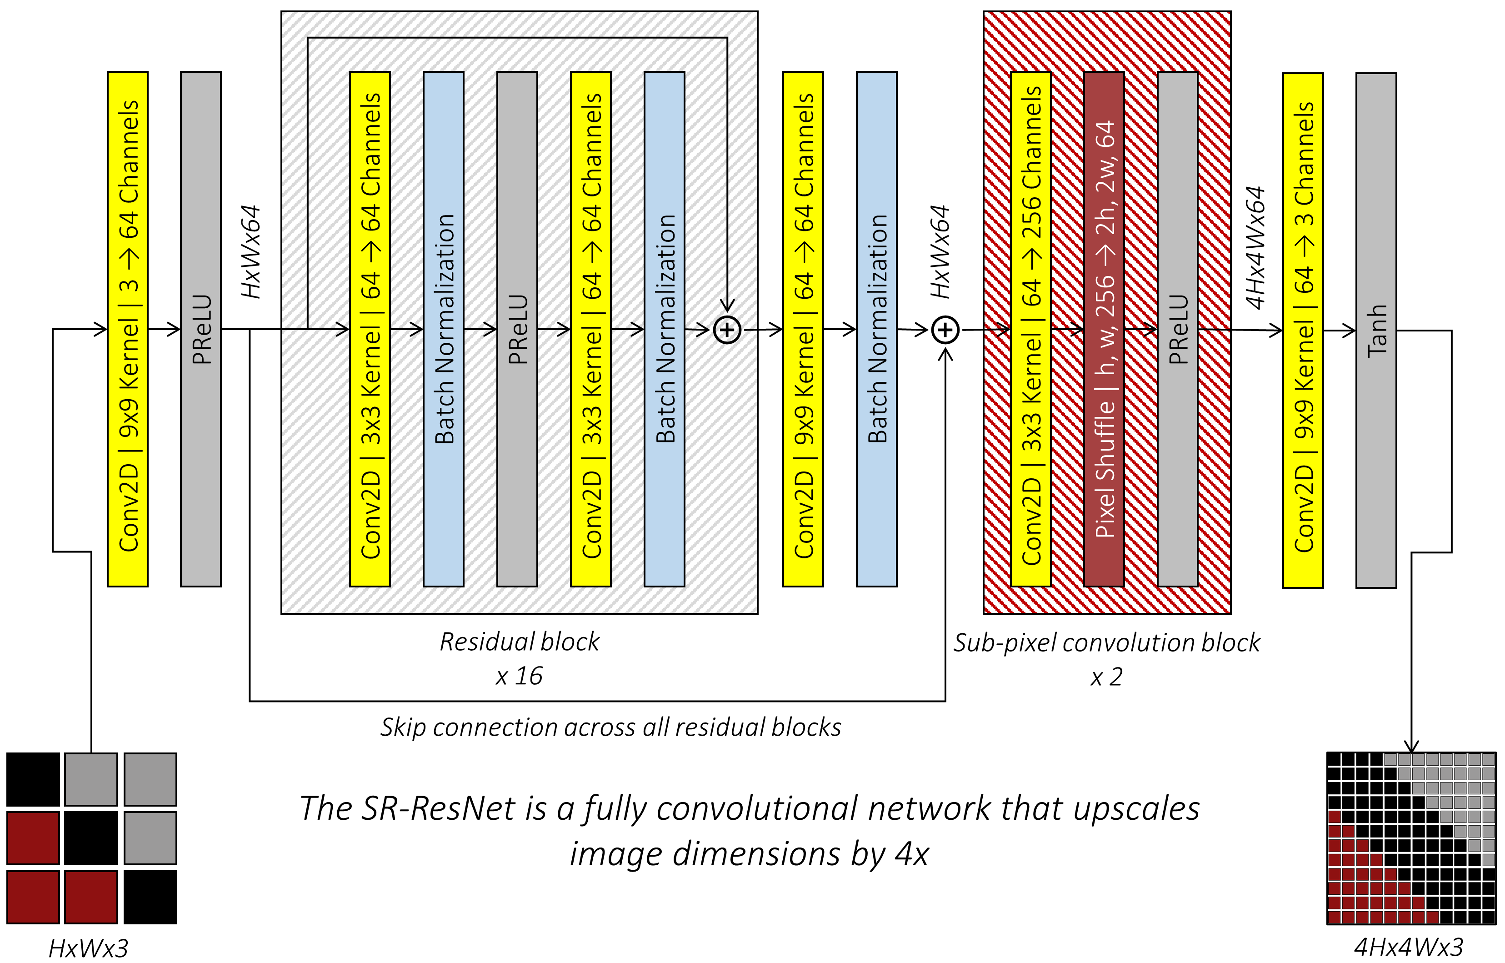

Slide 10
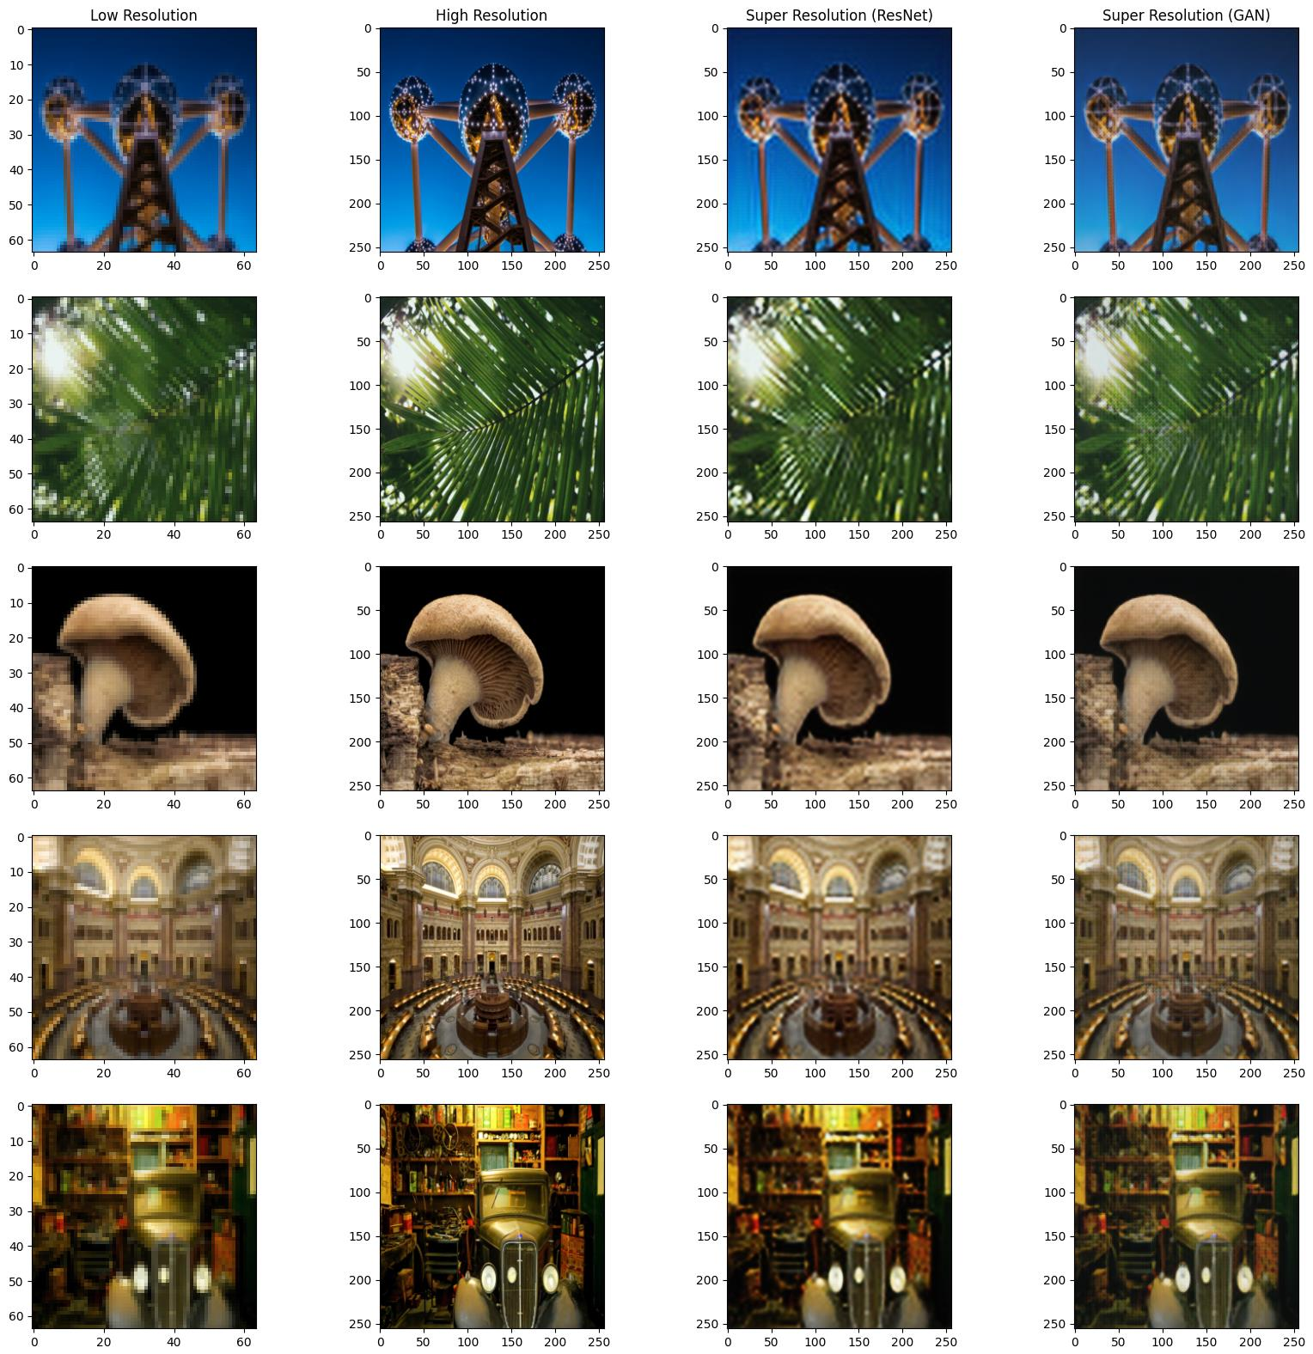
Sr-Res-Net Results

Slide 11
Sr-Res-Net Results

Slide 12
Sr-Res-Net Results

Slide 13

Sr-gan
This network use GAN architecture that introduced in 2014 [9].
In this network we use a generator that is similar to SR-ResNet and a discriminator.
The discriminator role is to identify fake image form real images.
This optimization problem in GAN networks is :
$$\min_{G}{\max_{D}{V\left(G,D\right)}}$$
where $V\left(G,D\right)=E_{p_{data}\left(x\right)}\left[D\left(x\right)\right]+E_{p_{z}\left(z\right)}\left[1−D\left(z\right)\right]$

Slide 14
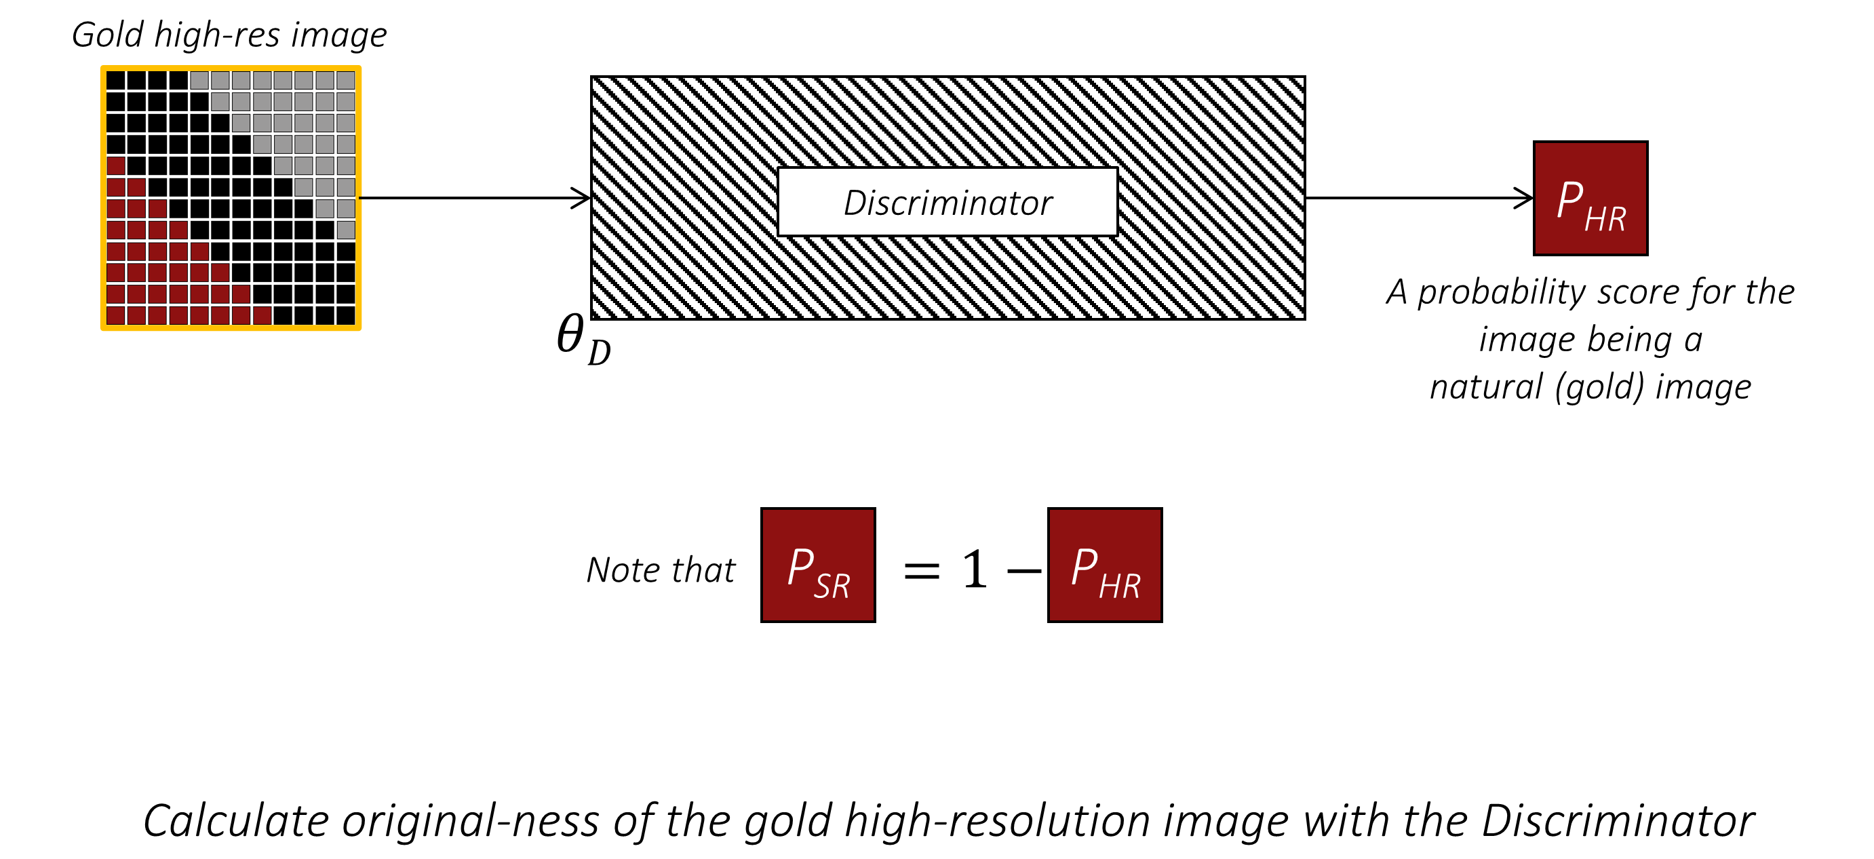

Slide 15
Loss Function
In SR-ResNet we use MSE loss function between SR and HR image. This loss function actually smooth SR image.
The alternative is to compute MSE loss in feature domain. Because the problem has many solution in spatial domain but limited solution in feature domain. For this task we use pre-trained VGG-19 network.
Loss function for GAN has 2 parts :
Generator loss = Content_Loss (SR_VGG, HR_VGG) + 0.001 ADV_Loss(SR, VALID).
Discriminator Loss = ADV_Loss(SR, FAKE) + ADV_Loss(HR, VALID)
All of code is available in “image_super_resolution.ipynb”.

Slide 16
Results And comparison

Slide 17

Graph convolution
Like convolution in grid domain, graph convolution is just and aggregation between neighbor nodes.
If we have signal $x={\left[x_{0},x_{1},…,x_{n−1}\right]}^{T}$, $S=A or L$ and filter $h={\left[h_{0},h_{1},…,h_{K−1}\right]}^{T}$ then :
$$x∗_{s}h=H\left(s\right)x=\sum_{k=1}^{K}{h_{k}S^{k}x}$$
This is linear convolution and it’s a generalized version of convolution on grid.

Slide 18
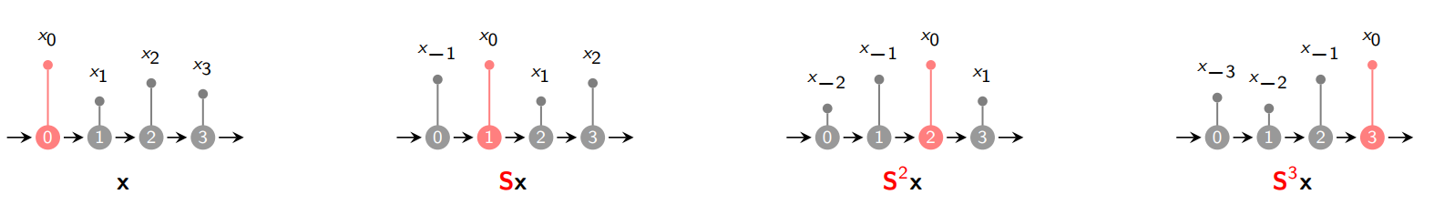
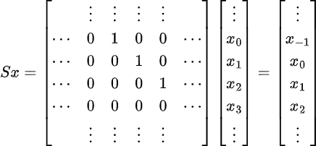
Graph convolution

Slide 19

Graph convolution
We can generalized this definition to more complex aggregation. So we define this as our generalized convolution :
$$x_{i}^{\left(l\right)}=γ^{\left(l\right)}\left(x_{i}^{\left(l−1\right)},⊕_{j∈N\left(i\right)}Φ^{\left(l\right)}\left(x_{i}^{\left(l−1\right)}, x_{j}^{\left(l−1\right)}, e_{j,i}\right)\right)$$
Our proposed convolution is called MRGCN that introduced in [10].
$$x_{i}^{\left(l\right)}=MLP\left(concat\left(x_{i}^{\left(l−1\right)},{\text{max}}_{j∈N\left(i\right)}\left(x_{j}^{\left(l−1\right)}−x_{i}^{\left(l−1\right)}\right)\right)\right)$$
We have to note that our graph is dynamic, not static, due it’s more capability.

Slide 20

Practical problems
Graph Convolutional Networks (GCNs) can not be deep and CNNs because of over-smoothing and complicated back propagation.
When multiple convolution layers stacked, the $x^{\left(l\right)}$ gradually converge to stable value. So out flexibility with deep architecture is lost. This problem is known as over-smoothing.
Despite CNNs, graph are complex, so there are multi path for back propagation and this means high memory and resource consuming.
All of these problems leads us to use shallow networks that in experiment, the depth is 2 or 3 layer.

Slide 21

Solutions
We define Residual connection as CNNs :
$$x_{i}^{\left(l\right)}=x_{i}^{\left(l−1\right)}+F\left(x_{i}^{\left(l−1\right)}\right)$$
We define dilated convolution for better view :
$x_{i}^{\left(l\right)}=MLP\left(concat\left(x_{i}^{\left(l−1\right)},{\text{max}}_{j∈N_{d}\left(i\right)}\left(x_{j}^{\left(l−1\right)}−x_{i}^{\left(l−1\right)}\right)\right)\right)$
With residual connection and dilated convolution we can defeat the over-smoothing problem but complicated back propagation is still there. So we have to use more shallow network than SR-ResNet and SR-GAN.

Slide 22
SR-GCN
This architecture is based on SR-ResNet but has fewer layers.
For this network we use 8 residual blocks instead of 16.
The number of hidden layer is reduced to 32.
Up-sampling is similar to SR-ResNet but we have to implemented this from scratch since to function is written for pixel shuffle in graph format.
Similar to pixel shuffle there is no written function for MRGCN. So we have to implement this from scratch.
All of code is available in “graph_super_resolution.ipynb”

Slide 23
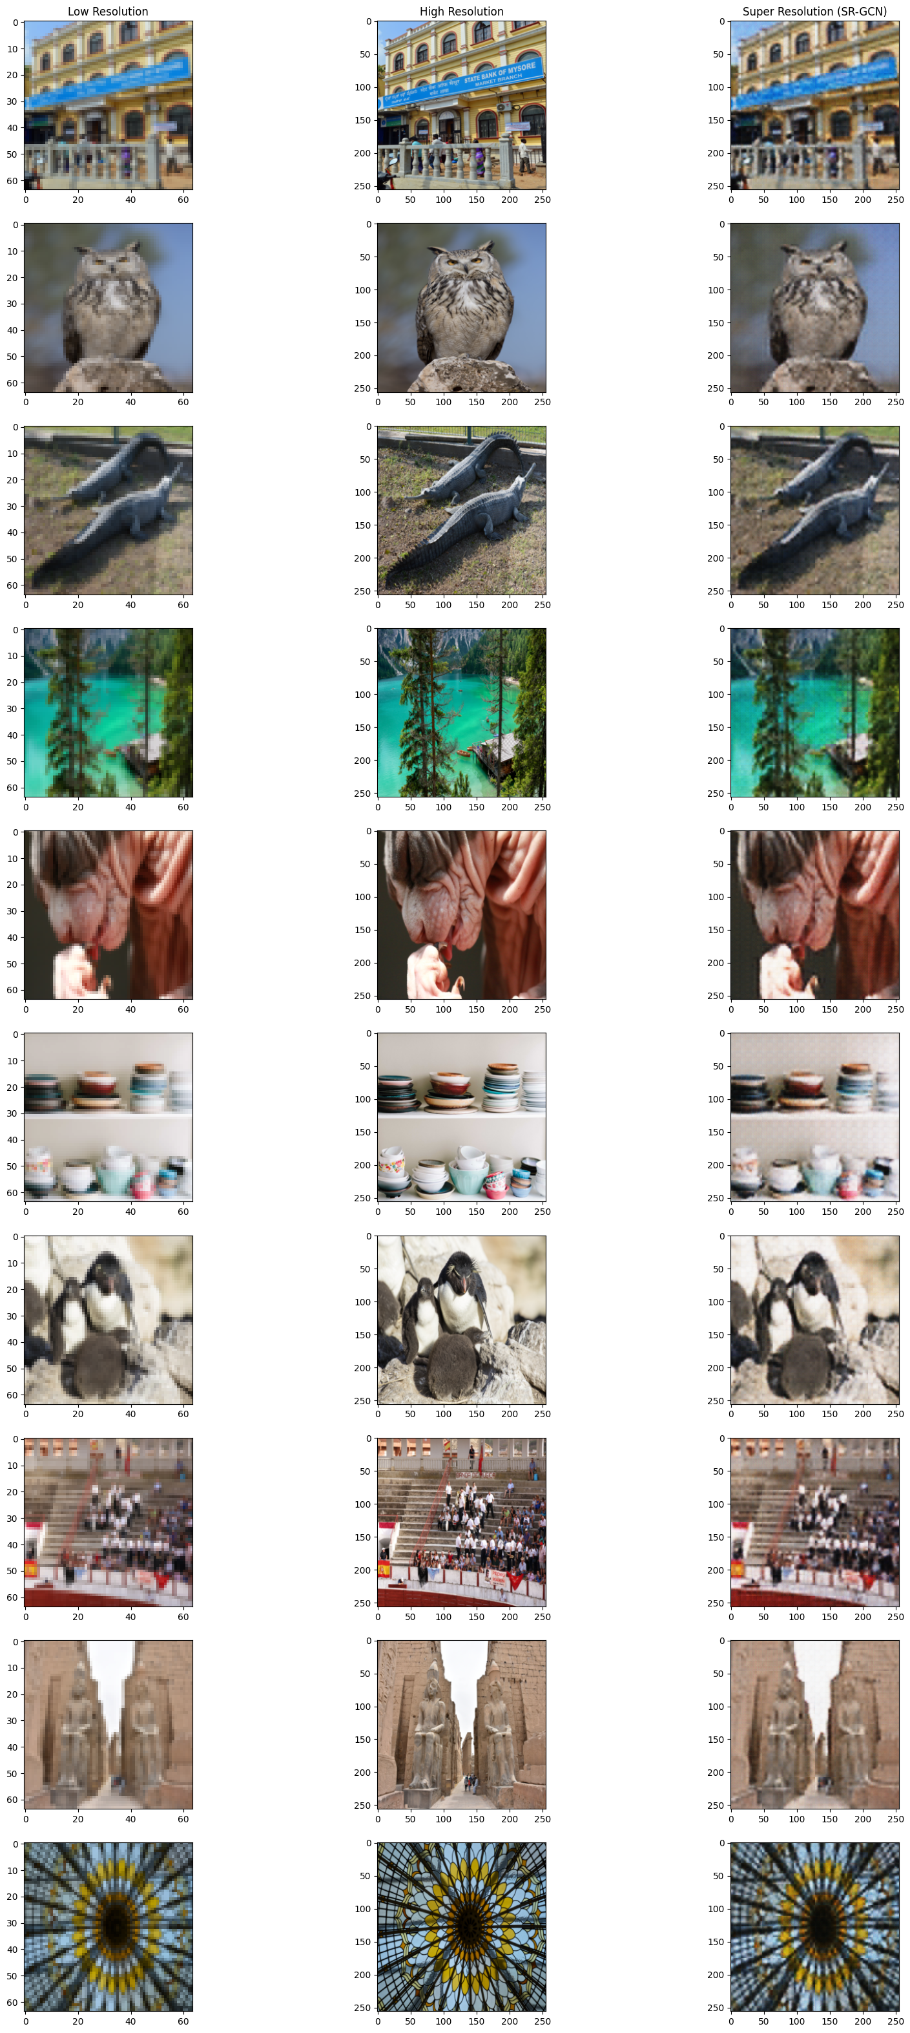
Results

Slide 24
Future improvement
We can add a discriminator block just like GAN, but with different convolution MRGCN. We haven’t do this because SR-GCN takes us a lot of time for training☹.
This picture are just 2d, but architecture is general for point clouds, panorama images and …, the only difference is in graph dataset.

Slide 25
References
[1] A Wavlet-Based Interpolation-Restortion Method For Superresolution, 2000.
[2] A computationally efficient superresolution image reconstruction algorithm, 2001.
[3] Improving resolution by image registration, 1991.
[4] High-resolution image reconstruction from lower-resolution image sequences and space varying image restoration, 1992.
[5] A fast MAP algorithm for high-resolution image reconstruction with multisensors, Multidimensional Systems and Signal Processing, 2001.
[6] Enhanced Deep Residual Networks for Single Image Super-Resolution, 2017.
[7] Photo-Realistic Single Image Super-Resolution Using a Generative Adversarial Network, 2016.
[8] Deep Residual Learning for Image Recognition, 2015.

Slide 26
References
[9] Generative Adversarial Networks, 2014.
[10] DeepGCNs: Making GCNs Go as Deep as CNNs, 2021.
[11] DeeperGCN: All You Need to Train Deeper GCNs, 2020.
[12] Simple and Deep Graph Attention Networks, 2022.
[13] Simple and Deep Graph Convolutional Networks, 2020.

Slide 27
Thanks for your attention
Author: Sepehr Kazemi – 99106599
Course: Image Processing (Computer Engineering Department)
Professor: Dr. Shohreh Kasaei
TA: Ali Safarpoor

